Slide 1

Chapter 9 Strings

Slide 2
Motivations
Often you encounter the problems that involve string processing and file input and output. Suppose you need to write a program to replace all occurrences of a word with a new word in a file. How do you solve this problem? This chapter introduces strings and text files, which will enable you to solve this problem.

Slide 3
Objectives
To use the String class to process fixed strings (§9.2).
To construct strings (§9.2.1).
To understand that strings are immutable and to create an interned string (§9.2.2).
To compare strings (§9.2.3).
To get string length and characters, and combine strings (§9.2.4).
To obtain substrings (§9.2.5).
To convert, replace, and split strings (§9.2.6).
To match, replace, and split strings by patterns (§9.2.7).
To search for a character or substring in a string (§9.2.8).
To convert between a string and an array (§9.2.9).
To convert characters and numbers into a string (§9.2.10).
To obtain a formatted string (§9.2.11).
To check whether a string is a palindrome (§9.3).
To convert hexadecimal numbers to decimal numbers (§9.4).
To use the Character class to process a single character (§9.5).
To use the StringBuilder and StringBuffer classes to process flexible strings (§9.6).
To distinguish among the String, StringBuilder, and StringBuffer classes (§9.2–9.6).
To learn how to pass arguments to the main method from the command line (§9.7).

Slide 4
The String Class
Constructing a String:
  String message = "Welcome to Java“;
  String message = new String("Welcome to Java“);
  String s = new String();
Obtaining String length and Retrieving Individual Characters in a string
String Concatenation (concat)
Substrings (substring(index), substring(start, end))
Comparisons (equals, compareTo)
String Conversions
Finding a Character or a Substring in a String
Conversions between Strings and Arrays
Converting Characters and Numeric Values to Strings

Slide 5
Constructing Strings
String newString = new String(stringLiteral);
String message = new String("Welcome to Java");
Since strings are used frequently, Java provides a shorthand initializer for creating a string:
String message = "Welcome to Java";

Slide 6
Strings Are Immutable
A String object is immutable; its contents cannot be changed. Does the following code change the contents of the string?
String s = "Java";
s = "HTML";

Slide 7

Trace Code
animation
String s = "Java";
s = "HTML";

Slide 8
Trace Code
animation
String s = "Java";
s = "HTML";

Slide 9
Interned Strings
Since strings are immutable and are frequently used, to improve efficiency and save memory, the JVM uses a unique instance for string literals with the same character sequence. Such an instance is called interned. For example, the following statements:

Slide 10
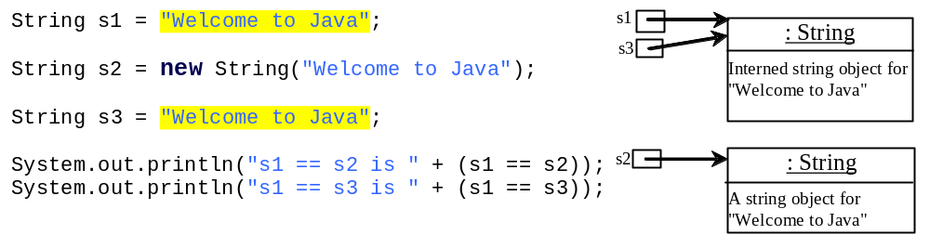
Examples
display
s1 == s is false
s1 == s3 is true
A new object is created if you use the new operator.
If you use the string initializer, no new object is created if the interned object is already created.

Slide 11
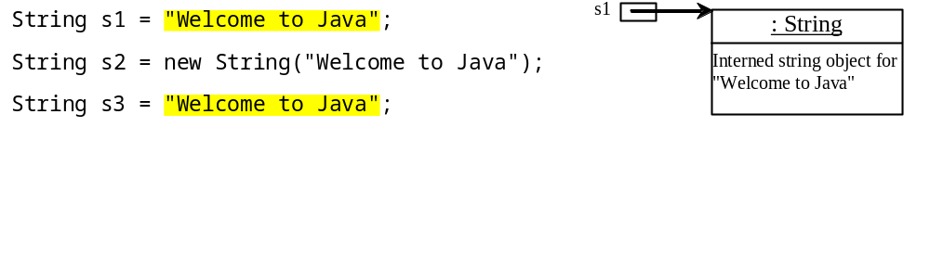
Trace Code
animation

Slide 12
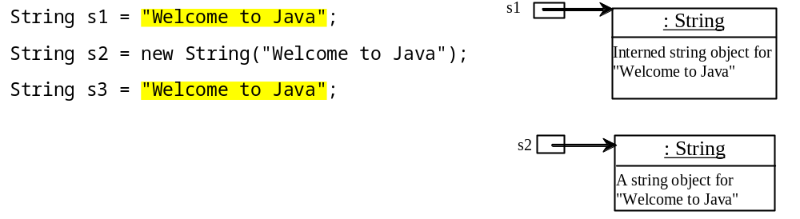
Trace Code

Slide 13
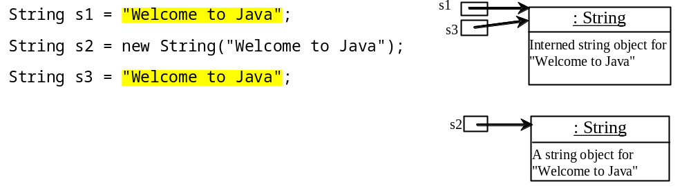
Trace Code

Slide 14
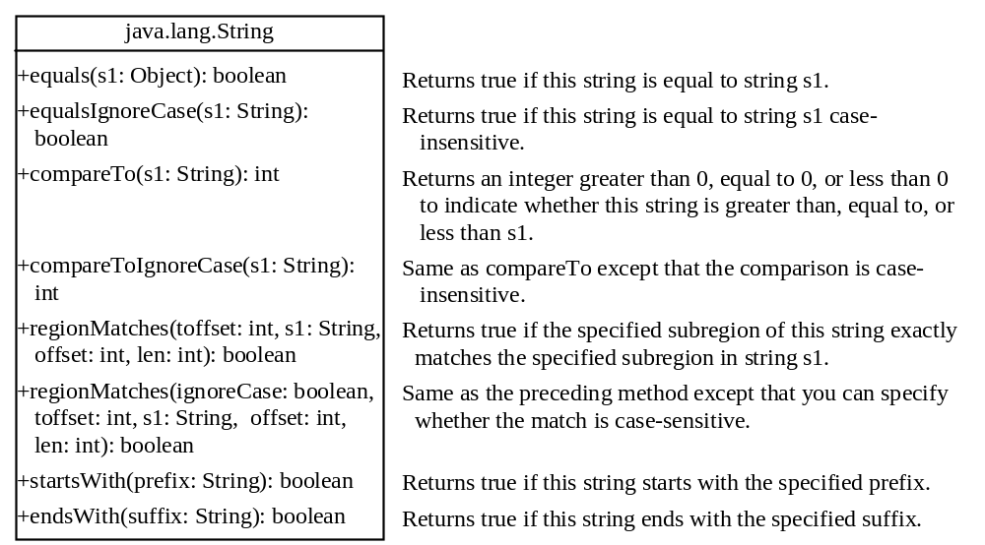
String Comparisons

Slide 15
String Comparisons
equals
String s1 = new String("Welcome“);
String s2 = "welcome";
if (s1.equals(s2)){
// s1 and s2 have the same contents
}
if (s1 == s2) {
// s1 and s2 have the same reference
}

Slide 16
String Comparisons, cont.
compareTo(Object object)
String s1 = new String("Welcome“);
String s2 = "welcome";
if (s1.compareTo(s2) > 0) {
// s1 is greater than s2
}
else if (s1.compareTo(s2) == 0) {
// s1 and s2 have the same contents
}
else
// s1 is less than s2

Slide 17
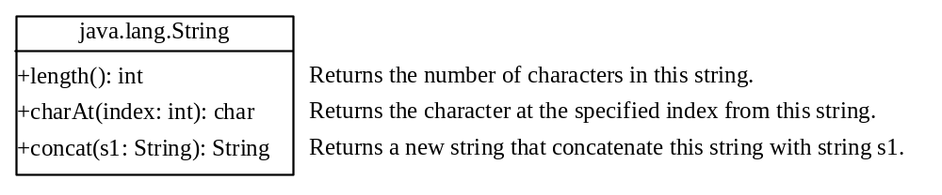
String Length, Characters, and Combining Strings

Slide 18
Finding String Length
Finding string length using the length() method:
message = "Welcome";
message.length() (returns 7)

Slide 19
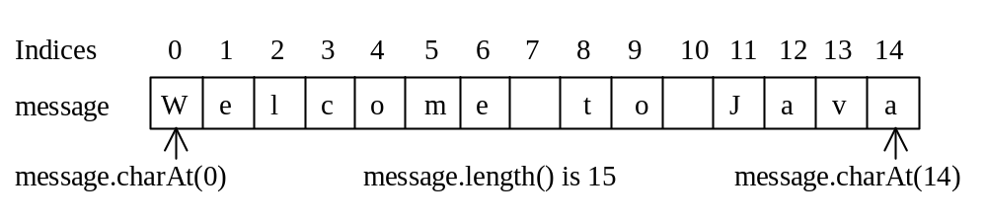
Retrieving Individual Characters in a String
Do not use message[0]
Use message.charAt(index)
Index starts from 0

Slide 20
String Concatenation
String s3 = s1.concat(s2);
String s3 = s1 + s2;
s1 + s2 + s3 + s4 + s5 same as
(((s1.concat(s2)).concat(s3)).concat(s4)).concat(s5);

Slide 21
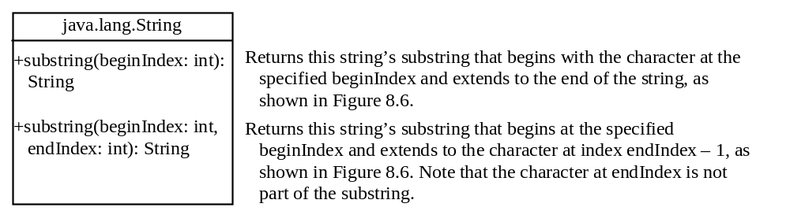
Extracting Substrings

Slide 22
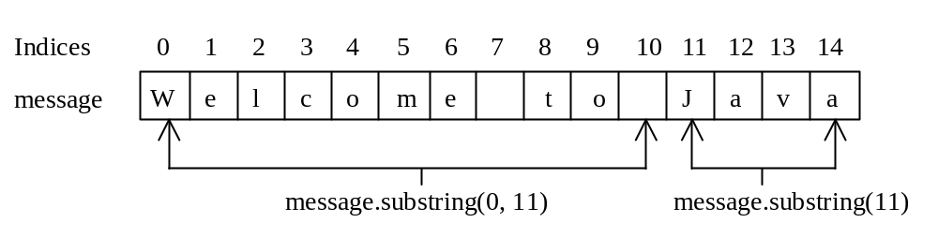
Extracting Substrings
You can extract a single character from a string using the charAt method. You can also extract a substring from a string using the substring method in the String class.
String s1 = "Welcome to Java";
String s2 = s1.substring(0, 11) + "HTML";

Slide 23
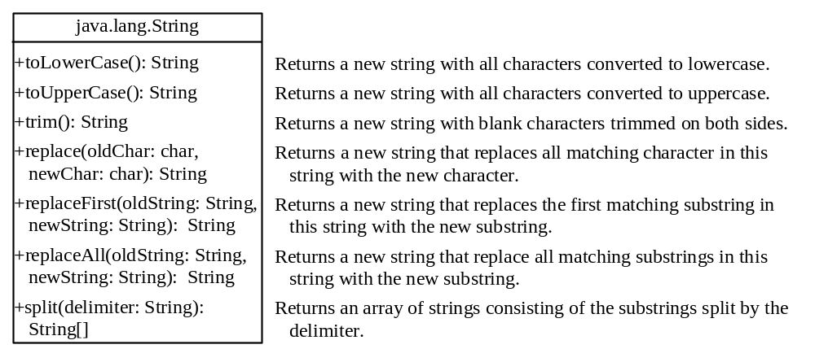
Converting, Replacing, and Splitting Strings

Slide 24
Examples
"Welcome".toLowerCase() returns a new string, welcome.
"Welcome".toUpperCase() returns a new string, WELCOME.
" Welcome ".trim() returns a new string, Welcome.
"Welcome".replace('e', 'A') returns a new string, WAlcomA.
"Welcome".replaceFirst("e", "AB") returns a new string, WABlcome.
"Welcome".replace("e", "AB") returns a new string, WABlcomAB.
"Welcome".replace("el", "AB") returns a new string, WABcome.

Slide 25
Splitting a String
String[] tokens = "Java#HTML#Perl".split("#", 0);
for (int i = 0; i < tokens.length; i++)
System.out.print(tokens[i] + " ");
displays
Java HTML Perl

Slide 26
Matching, Replacing and Splitting by Patterns
You can match, replace, or split a string by specifying a pattern. This is an extremely useful and powerful feature, commonly known as regular expression. Regular expression is complex to beginning students. For this reason, two simple patterns are used in this section. Please refer to Supplement III.F, “Regular Expressions,” for further studies.
"Java".matches("Java");
"Java".equals("Java");
"Java is fun".matches("Java.*");
"Java is cool".matches("Java.*");

Slide 27
Matching, Replacing and Splitting by Patterns
The replaceAll, replaceFirst, and split methods can be used with a regular expression. For example, the following statement returns a new string that replaces $, +, or # in "a+b$#c" by the string NNN.
String s = "a+b$#c".replaceAll("[$+#]", "NNN");
System.out.println(s);
Here the regular expression [$+#] specifies a pattern that matches $, +, or #. So, the output is aNNNbNNNNNNc.

Slide 28
Matching, Replacing and Splitting by Patterns
The following statement splits the string into an array of strings delimited by some punctuation marks.
String[] tokens = "Java,C?C#,C++".split("[.,:;?]");
for (int i = 0; i < tokens.length; i++)
System.out.println(tokens[i]);

Slide 29
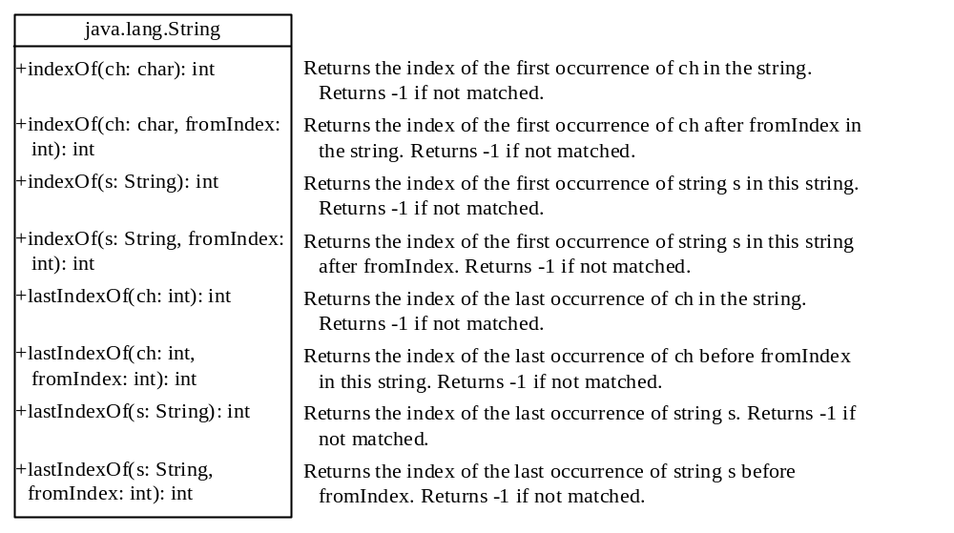
Finding a Character or a Substring in a String

Slide 30
Finding a Character or a Substring in a String
"Welcome to Java".indexOf('W') returns 0.
"Welcome to Java".indexOf('x') returns -1.
"Welcome to Java".indexOf('o', 5) returns 9.
"Welcome to Java".indexOf("come") returns 3.
"Welcome to Java".indexOf("Java", 5) returns 11.
"Welcome to Java".indexOf("java", 5) returns -1.
"Welcome to Java".lastIndexOf('a') returns 14.

Slide 31
Convert Character and Numbers to Strings
The String class provides several static valueOf methods for converting a character, an array of characters, and numeric values to strings. These methods have the same name valueOf with different argument types char, char[], double, long, int, and float. For example, to convert a double value to a string, use String.valueOf(5.44). The return value is string consists of characters ‘5’, ‘.’, ‘4’, and ‘4’.

Slide 32
Problem: Finding Palindromes
Objective: Checking whether a string is a palindrome: a string that reads the same forward and backward.
CheckPalindrome
Run

Slide 33
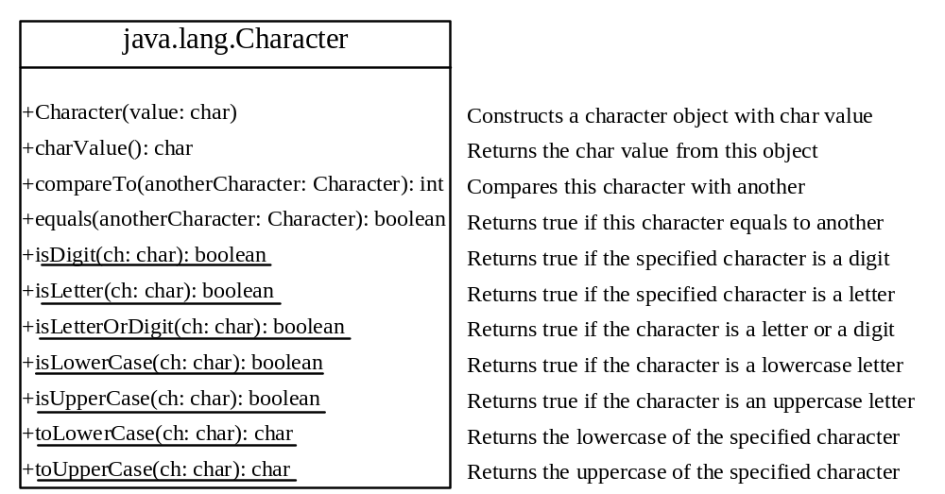
The Character Class

Slide 34
Examples
Character charObject = new Character('b');
charObject.compareTo(new Character('a')) returns 1
charObject.compareTo(new Character('b')) returns 0
charObject.compareTo(new Character('c')) returns -1
charObject.compareTo(new Character('d') returns –2
charObject.equals(new Character('b')) returns true
charObject.equals(new Character('d')) returns false

Slide 35
Problem: Counting Each Letter in a String
This example gives a program that counts the number of occurrence of each letter in a string. Assume the letters are not case-sensitive.
CountEachLetter
Run

Slide 36
StringBuilder and StringBuffer
The StringBuilder/StringBuffer class is an alternative to the String class. In general, a StringBuilder/StringBuffer can be used wherever a string is used. StringBuilder/StringBuffer is more flexible than String. You can add, insert, or append new contents into a string buffer, whereas the value of a String object is fixed once the string is created.

Slide 37
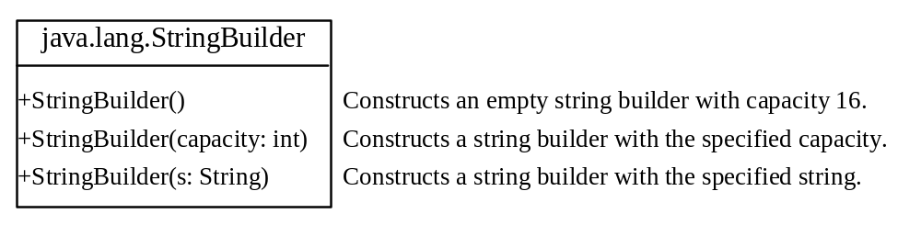
StringBuilder Constructors

Slide 38

Modifying Strings in the Builder

Slide 39
Examples
stringBuilder.append("Java");
stringBuilder.insert(11, "HTML and ");
stringBuilder.delete(8, 11) changes the builder to Welcome Java.
stringBuilder.deleteCharAt(8) changes the builder to Welcome o Java.
stringBuilder.reverse() changes the builder to avaJ ot emocleW.
stringBuilder.replace(11, 15, "HTML")
changes the builder to Welcome to HTML.
stringBuilder.setCharAt(0, 'w') sets the builder to welcome to Java.

Slide 40

The toString, capacity, length, setLength, and charAt Methods

Slide 41
Problem: Checking Palindromes Ignoring Non-alphanumeric Characters
This example gives a program that counts the number of occurrence of each letter in a string. Assume the letters are not case-sensitive.
PalindromeIgnoreNonAlphanumeric
Run

Slide 42
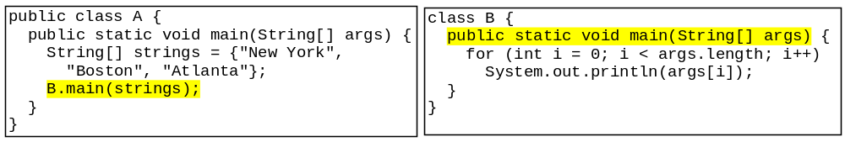
Main Method Is Just a Regular Method
You can call a regular method by passing actual parameters. Can you pass arguments to main? Of course, yes. For example, the main method in class B is invoked by a method in A, as shown below:

Slide 43
Command-Line Parameters
class TestMain {
public static void main(String[] args) {
...
}
}
java TestMain arg0 arg1 arg2 ... argn

Slide 44
Processing
Command-Line Parameters
In the main method, get the arguments from args[0], args[1], ..., args[n], which corresponds to arg0, arg1, ..., argn in the command line.
Notes:
Example 12.4

Slide 45
Problem: Calculator
Objective: Write a program that will perform binary operations on integers. The program receives three parameters: an operator and two integers.
java Calculator "2 + 3"
Calculator
java Calculator "2 - 3"
Run
java Calculator "2 / 3"
java Calculator "2 * 3"

Slide 46
Regular Expressions
Companion Website
A regular expression (abbreviated regex) is a string that describes a pattern for matching a set of strings. Regular expression is a powerful tool for string manipulations. You can use regular expressions for matching, replacing, and splitting strings.

Slide 47
Matching Strings
Companion Website
"Java".matches("Java");
"Java".equals("Java");
"Java is fun".matches("Java.*")
"Java is cool".matches("Java.*")
"Java is powerful".matches("Java.*")

Slide 48
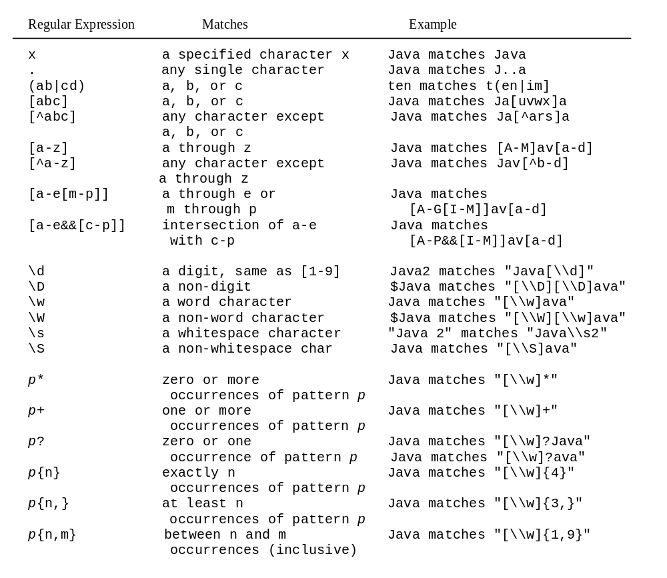
Regular Expression Syntax
Companion Website

Slide 49
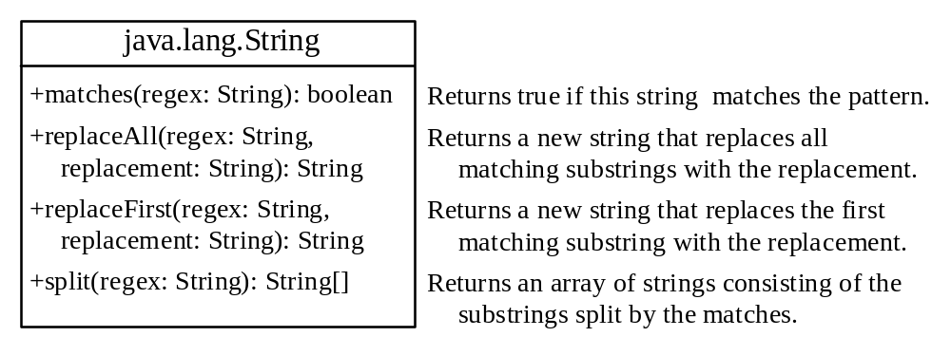
Replacing and Splitting Strings
Companion Website

Slide 50
Examples
Companion Website
String s = "Java Java Java".replaceAll("v\\w", "wi") ;
String s = "Java Java Java".replaceFirst("v\\w", "wi") ;
String[] s = "Java1HTML2Perl".split("\\d");

